Slide 2
INTRODUCTION
Context
Current state

Slide 3
CHOICES / TARGET
Organization of the code
Interfacing
Documentation
Variety of choices
GUI

Slide 4
GUI
Simplicity
Power
Diversity
Organization
Main window
Scan window
Filter window
Register window

Slide 5
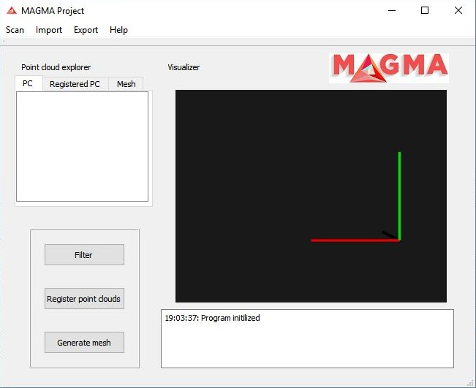
GUI – Main window

Slide 6
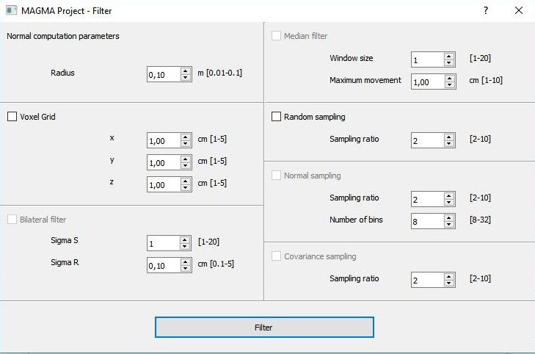
GUI – Filtering window

Slide 7
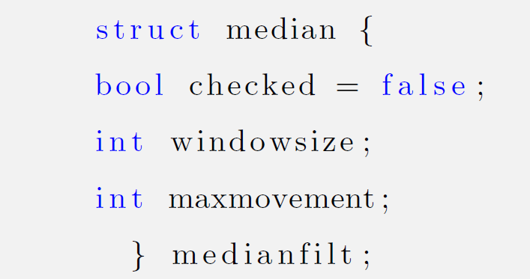
GUI - example

